Slide 1
Fractal Dimension For Top View

Slide 2
Sample 01 | Fractal Dimension | Porosity
1 | 1.08 | 0.05
2 | 0.94 | 0.03
3 | 1.02 | 0.04
4 | 0.82 | 0.02
5 | 0.94 | 0.03
6 | 0.98 | 0.03
7 | 1.06 | 0.05
8 | 1.00 | 0.04
9 | 0.96 | 0.03
10 | 0.95 | 0.03
11 | 1.00 | 0.04

Slide 3
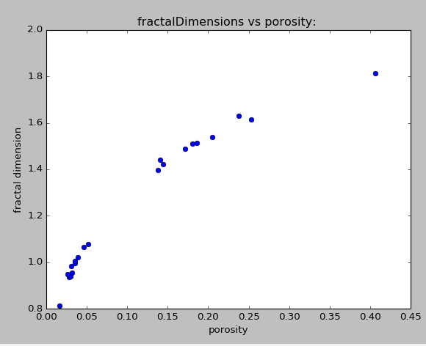
CRUD loop Case

Slide 4
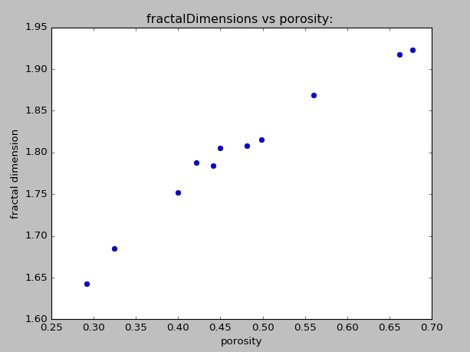
WestingHouse Case

Slide 5
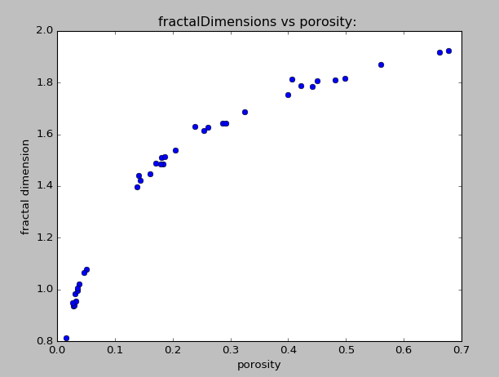
Both Cases

